Slide 1
How Are Your Zombie Accounts? Understanding Users' Practices and Expectations on Mobile App Account Deletion
Notes:
你的僵尸账户怎么样？ 了解用户对删除移动应用程序帐户的做法和期望

Slide 2

Motivation
The Right To Be Forgotten
Account Deletion

Slide 3

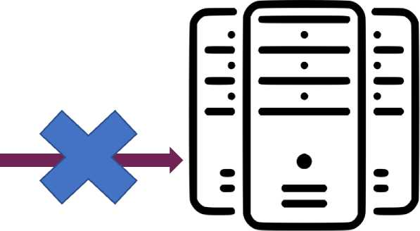

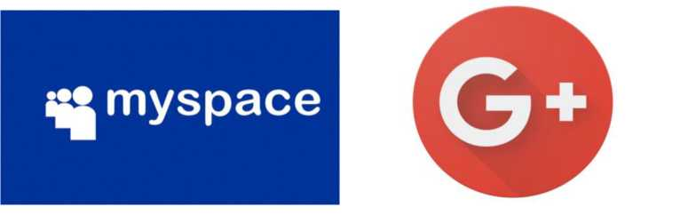
Motivation
• Omitted account deletion leads to zombie accounts
• The account deletion process lacks standard practices
! ZOMBIE !
ACCOUNT
INFORMATION
No Longer Used
Notes:
例如，对于Myspace和Google+等一些基本上已经很少人继续使用的平台，虽然用户可能有很多年不曾想起与使用，但是这些僵尸账号中的用户信息被长期保存，增加了个人信息泄露的风险。2016年5月Myspace公司收到了警告称平台中大量的用户名和密码已被黑客窃取，并在一个黑客论坛上出售。这其中就包括平台中大量僵尸账号所对应的用户数据

Slide 4
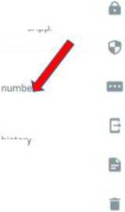

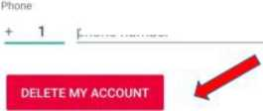
Motivation
• Omitted account deletion leads to zombie accounts
• The account deletion process lacks standard practices
How to Delete my account
Delete within the app
Open the browser
Send email or Contact customer service
No account deletion function
NO STANDARD
<r Settings
<- Account
<- Delete my account
Test_account
Hey there* I am using WhatsApp
Privacy
A
Deleting your account will:
Security
-Delete your account from WhatsApp
-Erase your message history
-Delete you from all of your WhatsApp groups
Account
Privacy, security, change
Two-step verification
E
Change number instead?
Chats
Change number
CHANGE NUMBER
Theme, wallpapers, chat history
Notifications Message, group & call tones
Request account info
Delete my account
To delete your account, confirm your country code and enter your phone number.
o
Storage and data
Network usage, auto-download
Country
United States
Help Help center, contact us, privacy policy
phone number
Invite a friend
from
00 Meta
Account deletion in Whatsapp

Slide 5
Research Questions
WEB context QoBILE context
• RQ1: [Necessity and Awareness]
Is account deletion necessary in people's daily life and are users aware of protecting data through account deletion?
• RQ2: [Practice and Understanding]
How many users exercised mobile account deletion in practice and how do they understand it?
• RQ3: [Feeling and Expectation]
Do account deletion designs in modern mobile apps meet users' expectations?

Slide 6
Main work
Pre-Study
Empirical measurement
Accout deletion process model
Questionnaire
Interview
647 participants
20 interviewees
RQ1 and RQ2
RQ3

Slide 7


Pre-Study
Pre-Study
60 apps from the Chinese app stores and the U.S.
Empirical measurement
Accout deletion process model
Register a new account
I
Use the app as a normal user
I
Delete the account
Questionnaire
Interview
647 participants
20 interviewees
RQ1 and RQ2
RQ3

Slide 8
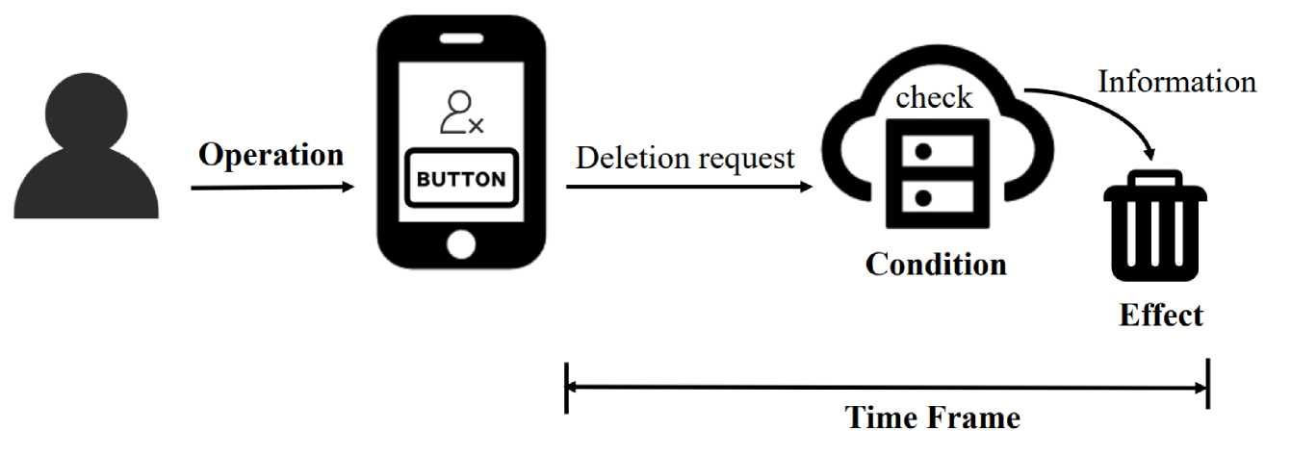
Pre-Study： Account Deletion Model
Operation： How to find the Deletion entry (Entry) and finish the account deletion request (Steps). Conditions： Check whether the requested account can be deleted.
Effect: The types of data to process and the processing methods (e.g., deletion or anonymization).
Time frame: The time vendors respond to the user's deletion request and fulfill the process.

Slide 9
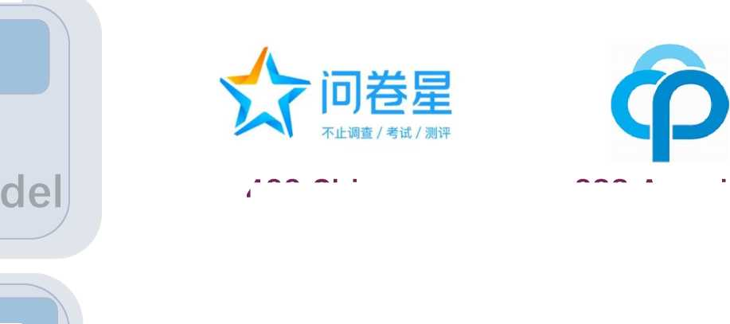

Online Questionnaire
Pre-Study
Empirical measurement
Accout deletion process model
400 Chinese
288 American
Questionnaire
Interview
688 Participants
shorter
2 minutes
647 participants
20 interviewees
RQ1 and RQ2
RQ3
longer
647 qualitative responses
DROP

Slide 10
Offline Interview
Pre-Study
Why Offline interview ?
Empirical measurement
Accout deletion process model
• Collect fresh-memory feelings.
Part 1: Experiment.
Completely deleted accounts of three apps.
Questionnaire
Interview
Part 2: Interview.
Asked some questions.
647 participants
20 interviewees
RQ1 and RQ2
RQ3

Slide 11
Result
• RQ1: [Necessity and Awareness]
Is account deletion necessary in people's daily life and are users aware of protecting data through account deletion?
• RQ2: [Practice and Understanding]
How many users exercised mobile account deletion in practice and how do they understand it?
• RQ3: [Feeling and Expectation]
Do account deletion designs in modern mobile apps meet users' expectations?

Slide 12
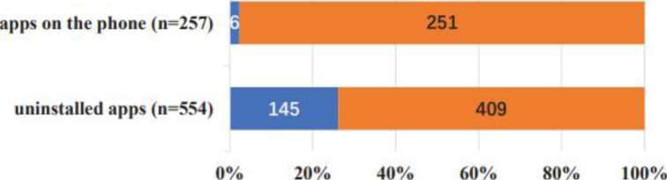
Result-RQl
• Awareness
89% concerned about their personal information.
78% indicated they were aware of the RTD.
75% held zombie accounts
0%
20%
40%
60%
80%
100%
■ Logout the account
■ Delete the account
■ Deactivate the account
■ Uninstall the app directly
■ Do nothing
■ Delete the account
■ No account deletion
(a) What would you do with those accidentally downloaded apps? (Q7)
(b) Did you delete the accounts for unused apps? (Q10, Q13)
Notes:
RTD: right to deletion (RTD)

Slide 13
Result-RQl
• Necessity
95%
were strongly desired to delete personal data in zombie accounts.
60%
expressed their concerns on zombie accounts.
Three kinds of troubles met by participants as not deleting accounts timely:
(1) Persistent promotional pushes. (60%, 21/35)
(2) Information disclosure. (34%, 12/35)
(3) Financial loss. (6%, 2/35)
had the experience that although it was the first time to use an app they accidentally used another person's account
22%

Slide 14
Result
• RQ1: [Necessity and Awareness]
Zombie accounts have non-negligible impacts on users and account deletion is necessary, which is what most people desire, but often be ignored in the daily life.
• RQ2: [Practice and Understanding]
How many users exercised mobile account deletion in practice and how do they understand it?
• RQ3: [Feeling and Expectation]
Do account deletion designs in modern mobile apps meet users' expectations?

Slide 15
Result
• RQ1: [Necessity and Awareness]
zombie accounts have non-negligible impacts on users and account deletion is necessary, which is what most people desire, but often be ignored in the daily life.
• RQ2: [Practice and Understanding]
How many users exercised mobile account deletion in practice and how do they understand it?
• RQ3: [Feeling and Expectation]
Do account deletion designs in modern mobile apps meet users' expectations?

Slide 16
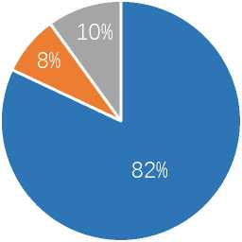
Result-RQ2
• Practice
Q16： Have you ever tried/thought of deleting an app account? Did you complete the deletion process?
Successfully deleted.
Tried, but couldn't delete.
Never tried to delete.
55% 15% 30%
“The service didn't have the option for deleting the account, at least not easily discoverable.'
66% (184/279) in American
V.s.
46% (171/368) in Chinese
“Too many steps'
■ Never consider deleting the accounts.
■ All the accounts are in active use.
■ Account deletion is unnecessary.

Slide 17
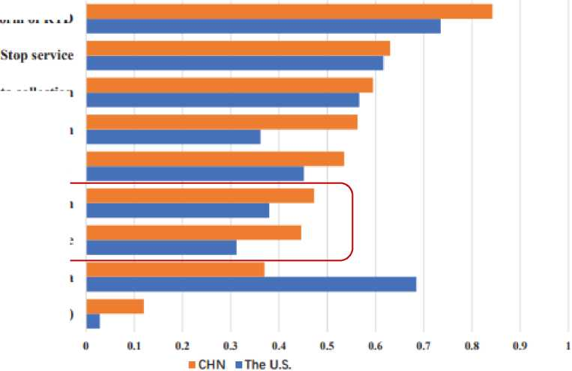
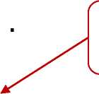
Result-RQ2
Understanding
Privacy Policy from Instagram
V. How can I manage or delete information about me?
W6 provide¹ you with the¹ ability to 5CC6SS, rectify, port dnd 6rdS€^ y Facebook Settings and Instagram Settings.
We store data until it is no longer necessary to provide our services and Meta Products, or until your account is deleted - whichever comes first. This is a case-by-case determination that depends on things like the nature of the data, why it is collected and processed, and relevant legal or operational retention needs. For example, when you search for something on Facebook, you can access and delete that query from within your search history at any time, but the log of that search is deleted after 6 months. If you submit a copy of your government-issued ID for account verification purposes, we delete that copy 30 days after review, unless otherwise stated. Learn more about deletion of content you have shared and cookie data obtained through social plugins.
When you delete your account, we delete things you have posted, such as your photos and status updates, and you won't be able to recover that information later. Information that others have shared about you isn't part of your account and won't be deleted. If you don't want to delete your account but want to temporarily stop using the Products, you can deactivate your account instead. To delete your account at any time, please visit the Facebook Settings and Instagram Settings.
Never read (37%) or only took a glance at (56%) the policy
A form 心f R I D
Stopcollection
Participants in China and the U.S. basically had
Re\ oke nuthorizdtion
Ne u^gieof data
similar understanding of the account deletion.
Delete pers^iiAl inforniation
Irreversible
Lower than 50%
Delete the ^h^red
Not responsible (Wrong)

Slide 18
Result
• RQ1: [Necessity and Awareness]
zombie accounts have non-negligible impacts on users and account deletion is necessary, which is what most people desire, but often be ignored in the daily life.
• RQ2: [Practice and Understanding]
More than half of the participants had successful account deletion experiences and the unfriendly design of the account deletion blocks a non-ignorable number of users. Most people, in general, do not understand or trust the real effect of account deletion.
• RQ3: [Feeling and Expectation]
Do account deletion designs in modern mobile apps meet users' expectations?

Slide 19
Result
• RQ1: [Necessity and Awareness]
zombie accounts have non-negligible impacts on users and account deletion is necessary, which is what most people desire, but often be ignored in the daily life.
• RQ2: [Practice and Understanding]
More than half of the participants had successful account deletion experiences and the unfriendly design of the account deletion blocks a non-ignorable number of users. Most people, in general, do not understand or trust the real effect of account deletion.
• RQ3: [Feeling and Expectation]
Do account deletion designs in modern mobile apps meet users' expectations?

Slide 20
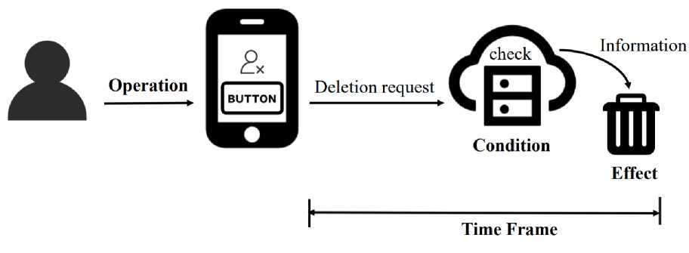
Result-RQ3
• Online (n=355)
Offline (n=20)
Participants who succeeded in deleting accounts
/ Q21: Is there any inconvenience in the process of
account deletion? (multi-select)
(a) No, there is nothing inconvenient about it.
(b) The deletion description is too complicated to understand.
(c) The deletion entry is hard to find.
(d) The deletion procedure is too complicated.
(e) The deletion preconditions are too strict.
(f)The deletion cannot be completed immediately
(g)Other ([free text])

Slide 21
Result-RQ3
• Operation- Entry
62% — Finding the account deletion entry
Users' actions Vendors' design
13.04 clicks V・S. 4.01 clicks
“This app seems to intentionally not want me to find the account deletion portal"
"Please put it in an easy to find location."
“I think most apps should make it easy to delete, often it is hard to find the option-

Slide 22
Result-RQ3
• Operation- Steps
51% —Complicated account deletion process
Notification.
14/20 Not read the deletion notice.
Reason gathering.
11/17 thought acceptable.
Authentication.
14/18 hold positive opinions.
“/ mainly care about the effect of the deletion, like what gets deleted"'
“/ don't think choosing reason is meaningful, / just picked randomly Anyway, / don't want to use it anymore.
“When / was in the account deletion process, / must be already logged in- So why need / confirm my identity again?

Slide 23
Result-RQ3
• Condition
14%— The deletion preconditions are too strict
a. Conditions requiring user's operation
“Apps could provide a button directly linked to the preprocess page for users to operate when they delete the account."
b. Conditions for security or business requirements
“After thirty days, i would forget that there is an account waiting to be deleted-Seven days or less would be better."

Slide 24
Result-RQ3
• Time Frame
42% —Cannot be completed deletion immediately
Users' expectation Vendors' design
7 days V・S. 14.75 days
Experctation
88% To be notified when the deletion was finished.
48% Keep the right to withdraw deletion.

Slide 25

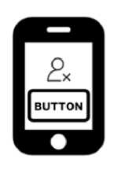
Result-RQ3
• Effect
What information to be deleted ?
Identity information — 87%
1
2
The account information — 86%
“Accounts should be deleted in full.”
“It shouldn't be a hustle and all apps should be able to delete all the information about users.”
32%
"Delete all users' personal information"

Slide 26
Result
• RQ1: [Necessity and Awareness]
zombie accounts have non-negligible impacts on users and account deletion is necessary, which is what most people desire, but often be ignored in the daily life.
• RQ2: [Practice and Understanding]
More than half of the participants had successful account deletion experiences and the unfriendly design of the account deletion blocks a non-ignorable number of users. Most people, in general, do not understand or trust the real effect of account deletion.
• RQ3: [Feeling and Expectation]
Only less than one-third considered no inconvenience was found during the deletion. The account deletion implementations of the apps today don't meet users' expectations and may even block users from exercising RTD.

Slide 27
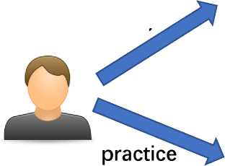
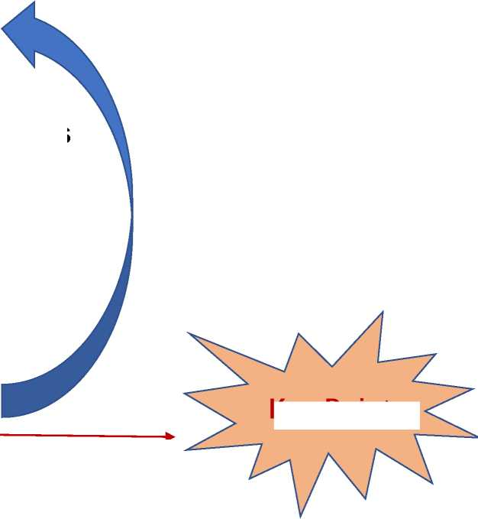
Discussion
RTD and account deletion are highly demanded.
desire
Inconsistent
Forget to deal with their zombie accounts
expectation
realistic privacy and security risks
An easy and clear way to delete accounts
Gaps
Key Point
to keep users
Unfriendly deletion implementations

Slide 28
Recommendation
• Improve users' consciousness.
• Simplify the account deletion operations.
• Improve the transparency.
• Comprehensive and user-definable settings.
• Bolster users' confidence.

Slide 29
Conclusion
• New issue revealed.
The mobile account deletion from the user perspectives.
• New design gap identified.
The app account deletion design today and users' expectations.
• New suggestions.
Suggestions for designers and vendors.

